Slide 2
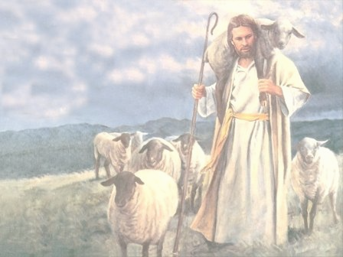
THE CHIEF SHEPHERD
“Coming for His Sheep”
Psalm 24

Slide 3
Psalm 24
A psalm of David
¹ The earth is the Lord’s, and everything in it.
The world and all its people belong to him.
² For he laid the earth’s foundation on the seas
and built it on the ocean depths.
³ Who may climb the mountain of the Lord?
Who may stand in his holy place?
⁴ Only those whose hands and hearts are pure,
who do not worship idols
and never tell lies.
Everyone Reads
Narrator – 1
Narrator – 2

Slide 4
⁵ They will receive the Lord’s blessing
and have a right relationship with God their savior.
⁶ Such people may seek you
and worship in your presence, O God of Jacob.
Interlude
⁷ Open up, ancient gates!
Open up, ancient doors,
and let the King of glory enter.
⁸ Who is the King of glory?
The Lord, strong and mighty;
the Lord, invincible in battle.
⁹ Open up, ancient gates!
Open up, ancient doors,
and let the King of glory enter.
¹⁰ Who is the King of glory?
The Lord of Heaven’s Armies—
he is the King of glory.
Everyone Reads
Narrator – 1
Everyone Reads
Narrator - 2

Slide 5
THE CHIEF SHEPHERD
“Coming for His Sheep”
Psalm 24

